Slide 1

· ML · SMART MANAGEMENT
PredictaShelf
Smart Shelf Life Management Using Machine Learning
Team Members: Saniya • Pooja • Vaishnavi • Sudeep • Montu• Rajan
Institution: SYSKRITI
Guide: Prof. Shri Singh
Predict today, save Tomorrow
Notes:
Predict Today,Save Tommorow.

Slide 2
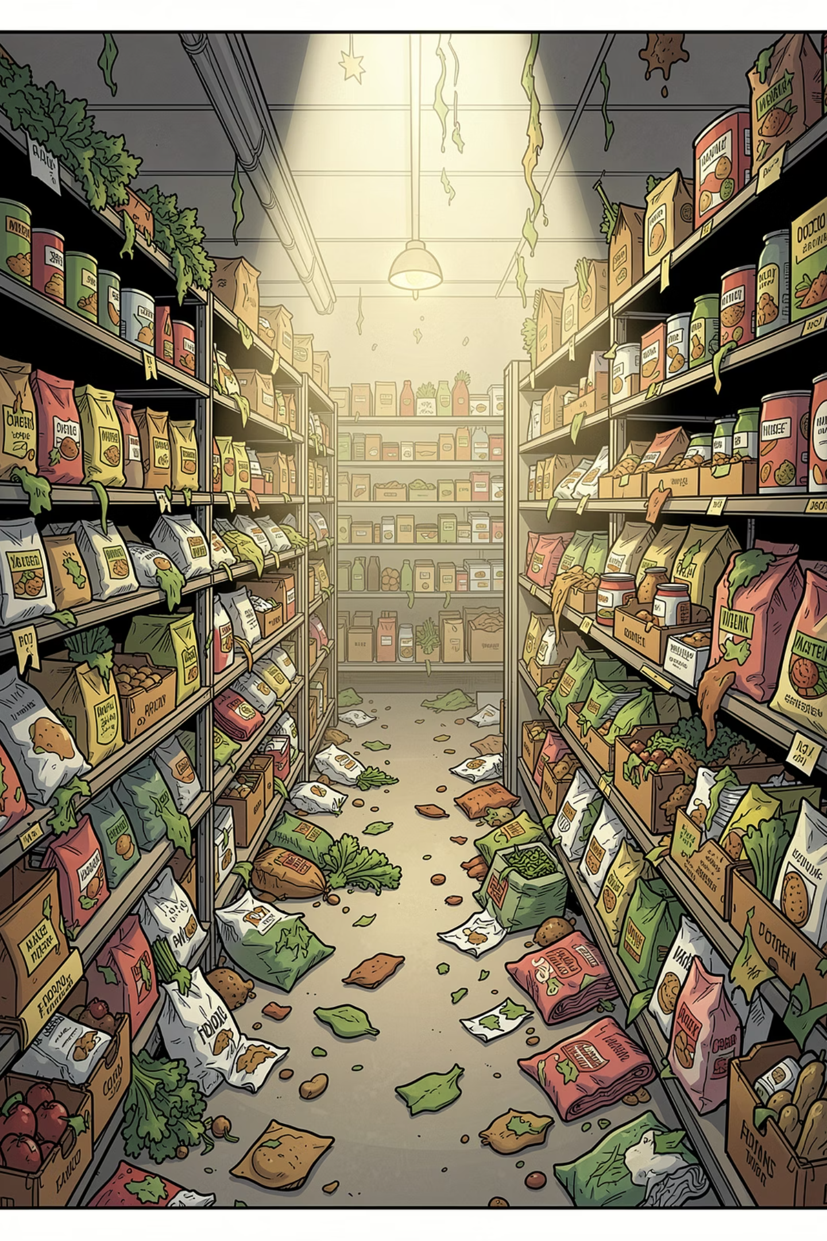
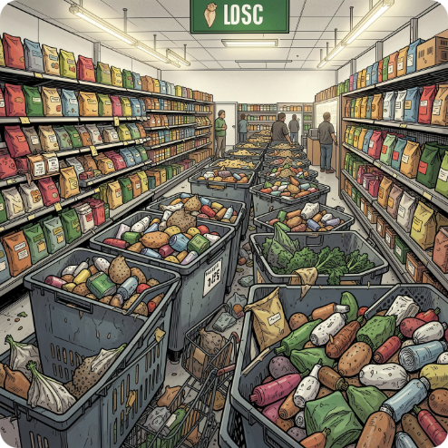
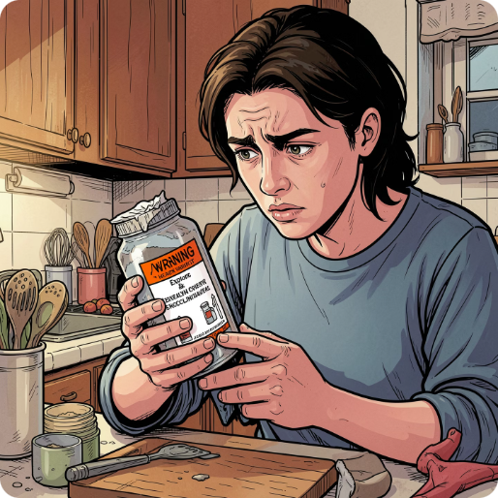
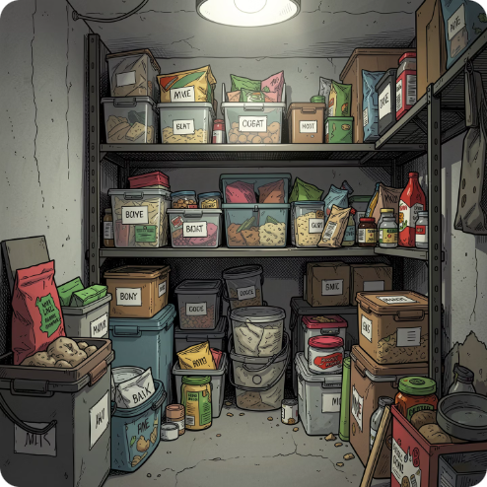
The Problem We're Solving
Food Wastage
Health Hazards
No Smart Tracking
About 1.3 billion tonnes of food are wasted every year worldwide (FAO). When expiry dates are not tracked, homes and stores lose billions.
Expired products can cause serious health problems. People need a smart system to warn them in time.
Traditional inventory systems do not use AI. Manual checks take time and are easy to get wrong.

Slide 3




WORKFLOW
Our Workflow: From Data to Decision
Our PredictaShelf system follows a systematic process to deliver accurate shelf life predictions. From gathering raw data to continuously refining our models, each step ensures optimal performance and valuable insights for smart inventory management.
Data Acquisition
Collect raw product and environmental data.
Preprocessing
Clean, normalize, and feature-engineer inputs.
Model Training
Train predictive models and validate performance.
Deployment & Monitoring
Integrate models and continuously monitor accuracy.
Predict today, save Tomorrow

Slide 4
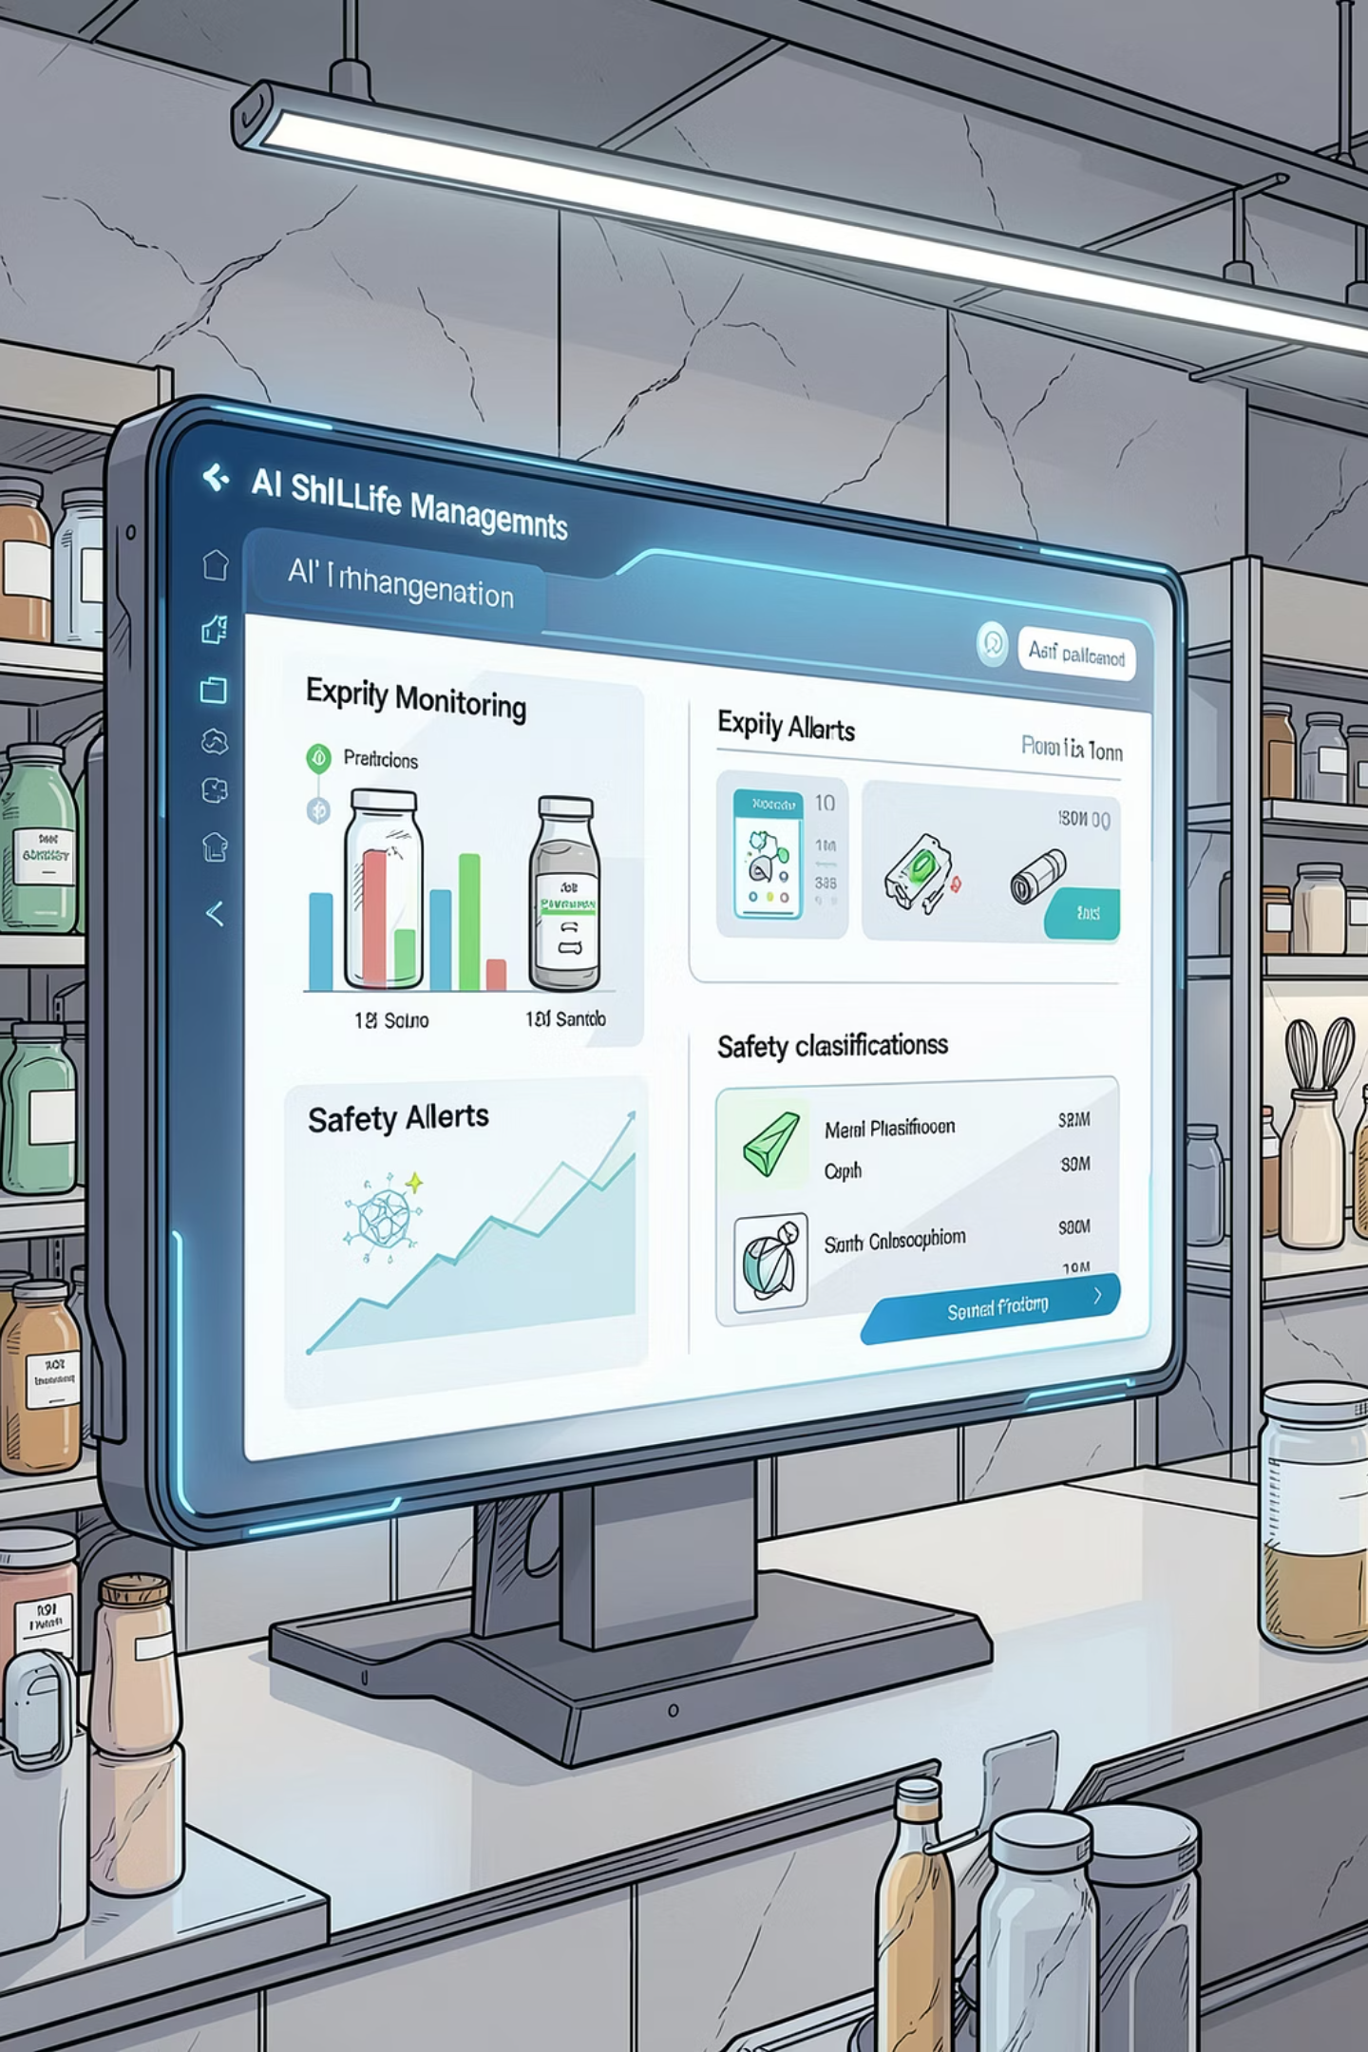


Our Solution — PredictaShelf
An AI-powered system that predicts expiry, classifies safety, and alerts users — all in one smart dashboard.
Safety Classification
Expiry Prediction
Labels every item as Safe, Near-Expiry, or Expired using ML classification.
Predict temperature remaining shelf life using product type,, and humidity data.
AI Core Engine
Smart Alerts
Five ML models work in tandem — regression, classification, and clustering — for end-to-end intelligence.
Notifies users before items expire via push notifications and dashboard warnings.
Product Grouping
Clusters similar products for smart storage optimization and batch expiry alerts.
Predict today, save Tomorrow

Slide 5


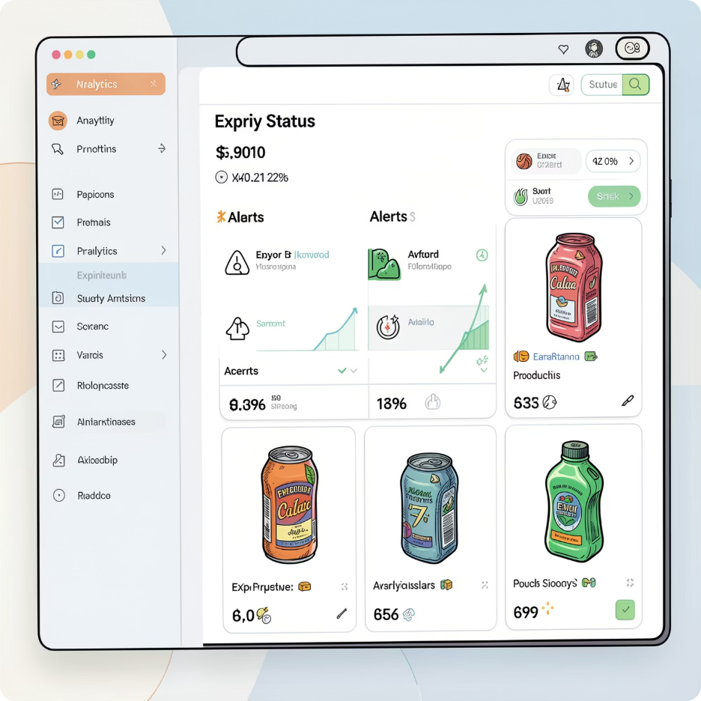
System Architecture
PredictaShelf follows a clean, end-to-end data pipeline — from raw user input to intelligent, actionable output on the dashboard.
User Input
ML Modls
Dashboard
Each stage is powered by a dedicated ML model, ensuring accurate predictions, and an intuitive visual interface for both household and retail users.
Predict today, save Tomorrow

Slide 6
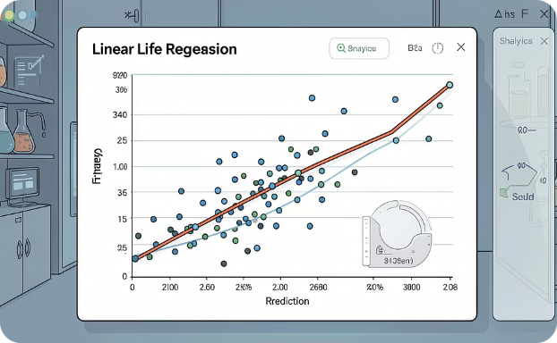
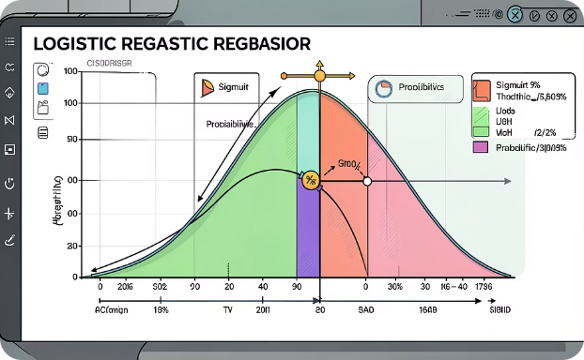
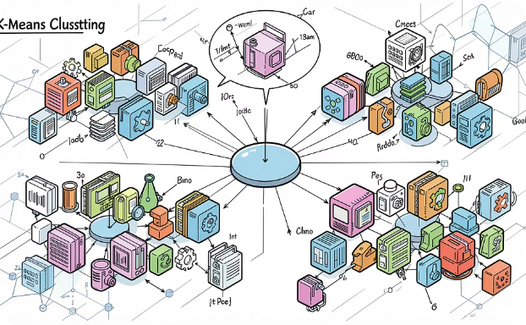
Machine Learning Models — Overview
Linear Regression
Logistic Regression
K-Means Clustering
Predicts days remaining until expiry using temperature, humidity, and product type.
Classifies items as Safe (1) or Unsafe (0) using a sigmoid probability threshold.
Groups similar products for smart storage and batch expiry recommendations.
Predict today, save Tomorrow

Slide 7
Model Deep Dive — Regression & Classification
01 · LINEAR REGRESSION
02 · LOGISTIC REGRESSION
Expiry Prediction
Safe / Unsafe Classification
Inputs: Product type, temperature (°C), humidity (%), storage conditions
Formula: Y = β₀ + β₁X₁ + β₂X₂ + … + ε
Output: Days remaining until expiry + confidence interval
Sigmoid Function: P(y=1) = 1 / (1 + e^(−z))
Threshold 0.5 determines the final classification label.
✅ SAFE
⚠️ UNSAFE
Sufficient shelf life. Safe to consume.
Expired or critical. Alert triggered.
Predict today, save Tomorrow

